Slide 1
Intro to Cloud Computing CS4037 (BCS-6A) Lecture 17
Dept. of Computer Science
FAST School of Computing
NUCES Lahore

Slide 2
Module 8: Databases
AWS Academy Cloud Foundations

Slide 3
Section 4: Amazon Aurora
Module 8: Databases

Slide 4

Amazon Aurora
Enterprise-class relational database
Compatible with MySQL or PostgreSQL
Automate time-consuming tasks (such as provisioning, patching, backup, recovery, failure detection, and repair).
Amazon Aurora

Slide 5
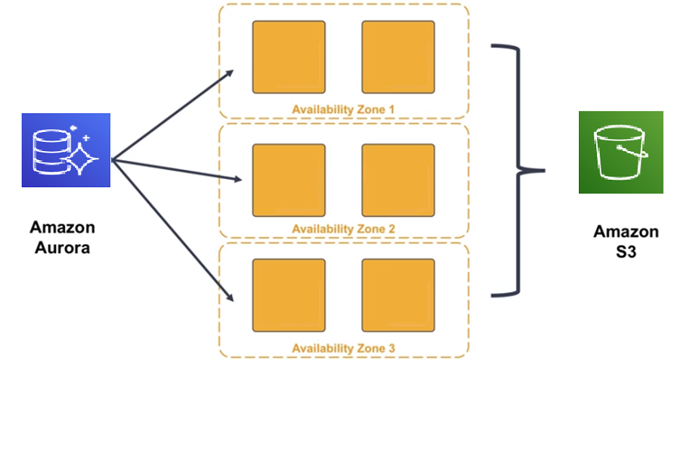
High Availability
Stores copies of data across multiple Availability Zones
With continuous backups to S3
Can use up to 15 read replicas servers.
Instant crash recovery if primary database becomes unhealthy.

Slide 6
The right tool for the right job
What are my requirements?
Enterprise-class relational database | Amazon RDS / Amazon Aurora
Fast and flexible NoSQL database service for any scale | Amazon DynamoDB
Operating system access or application features that are not supported by AWS database services | Databases on Amazon EC2
Specific case-driven requirements (machine learning, data warehouse, graphs) | AWS purpose-built database services e.g. Redshift

Slide 7

Section 4 key takeaways
Amazon Aurora features:
Fully managed
Compatible with MySQL and PostgreSQL
Multiple levels of security
Network isolation using VPC
Encryption of data at rest using AWS KMS
Encryption of data in transit using SSL
High availability and durability

Slide 8
Module wrap-up
Module 8: Databases

Slide 9
Module summary
In summary, in this module, you learned how to:
Explain Amazon Relational Database Service (Amazon RDS)
Identify the functionality in Amazon RDS
Explain Amazon DynamoDB
Identify the functionality in Amazon DynamoDB
Explain Amazon Redshift
Explain Amazon Aurora
Perform tasks in an RDS database, such as launching, configuring, and interacting

Slide 10
Additional resources
AWS Database page: https://aws.amazon.com/products/databases/
Amazon RDS page: https://aws.amazon.com/rds/
Overview of Amazon database services: https://docs.aws.amazon.com/whitepapers/latest/aws-overview/database.html
Getting started with AWS databases: https://aws.amazon.com/products/databases/learn/

Slide 11
Thank you
All trademarks are the property of their owners.

